Slide 1
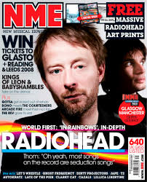
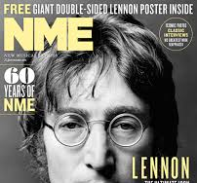
A written evaluation of the online readership of NME, Time Out and Kerrang music magazines

Slide 2
NME is to be taken free and given a circulation boost to 300,000, as publisher Time Inc UK looks to breathe new life into the struggling music magazine.
The title, which was launched in 1952, has seen weekly sales plummet in the last decade with a paid circulation currently just over 15,000.
The £2.50 magazine continues to see sales fall at a rate of 20% annually, and Time Inc is seeking to revitalise the title by taking it free from September.

