Slide 1
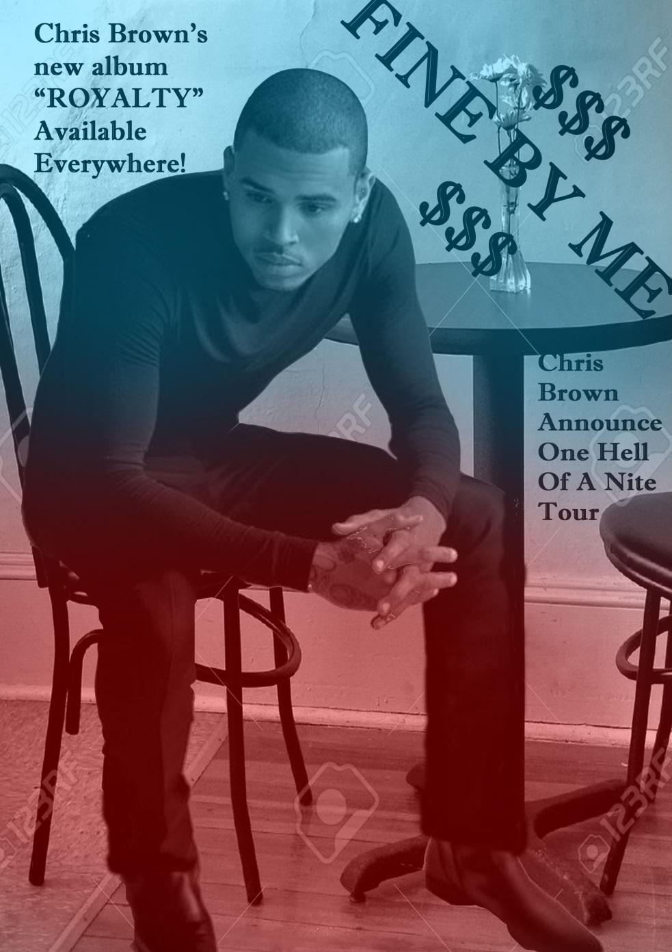
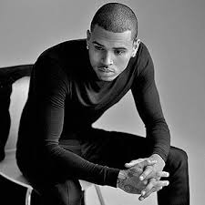
Change in the pictures 2
I decided to give it an extra background, I added in writing and info on his genre of music, and I gave the picture more colour 3D pattern.

