Slide 3
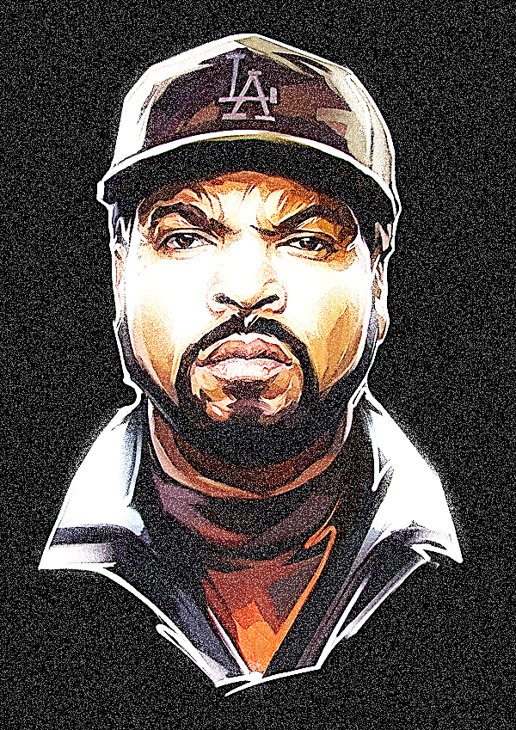
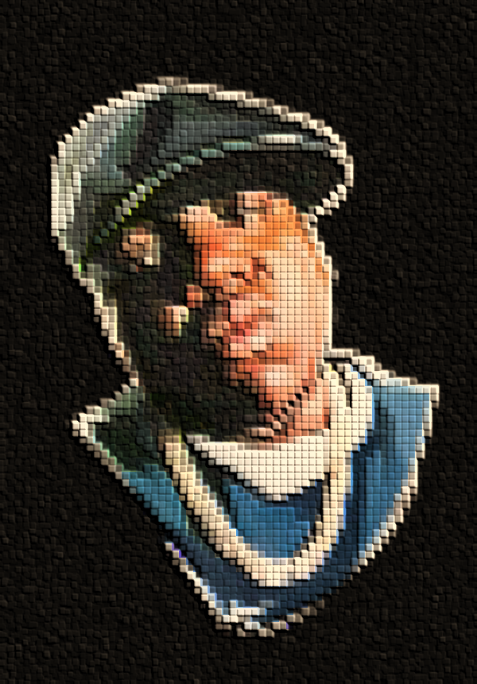

Slide 4
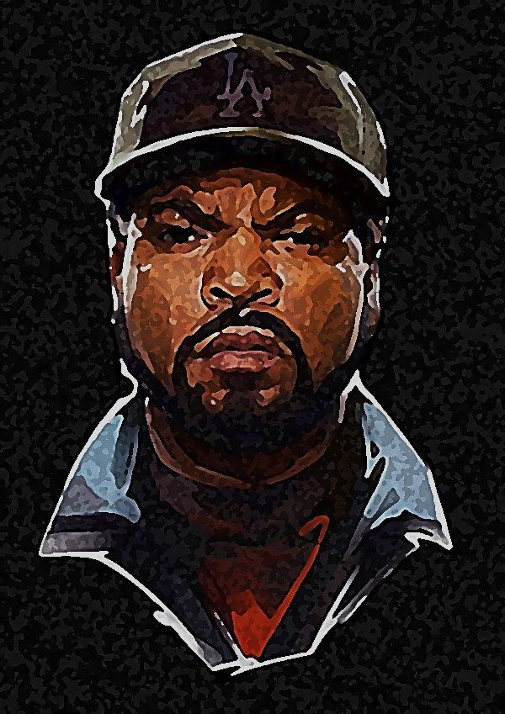

Slide 5
I did this by formatting the pictures and designing them in a different way such as the first slide that was how they were before until I did 3 more and designed them differently.

