Slide 1
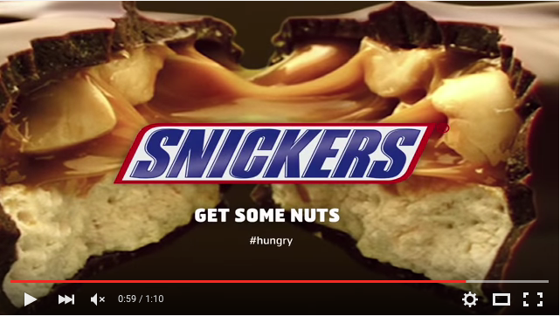
Mr. Bean snickers ad
deconstruction

Slide 2
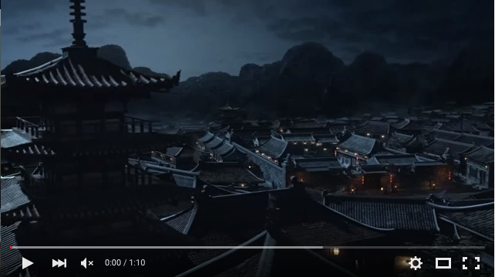
In this scene we see it starts off in a particular place that looks similar to China. So where this ad looks like its meant to take place in China.

Slide 3
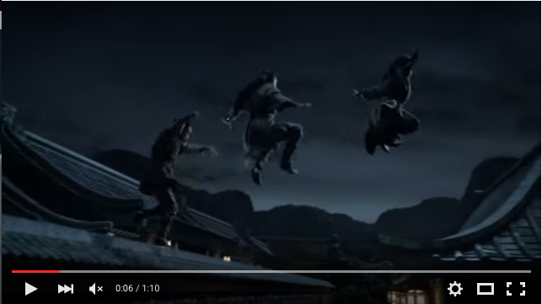
On this scene it shows three well skilled Ninjas that are jumping from roof to roof. You can also tell that there Ninjas because of the costumes and look that they use.

Slide 4
In this shot it seems to be they have added in a well known character known as Mr. Bean who seems to be doing really bad at being a Ninja.

Slide 5
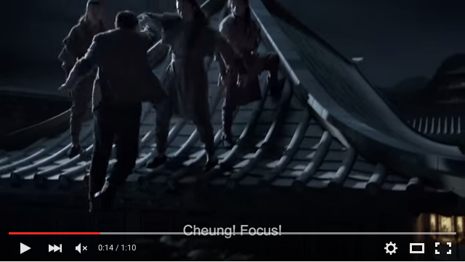
In this scene it shows the other Ninjas helping him up and one Ninja seems to have called him Cheung not Bean. So seems to be happening is that Cheung (Bean) is not him self and is acting like a fool.

Slide 6
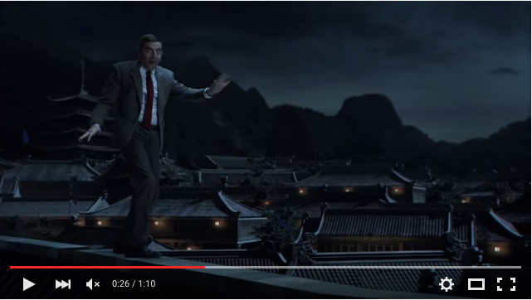
On this scene it shows Cheung not being skilled but instead very careful on how he is moving around by his gesture.

Slide 7
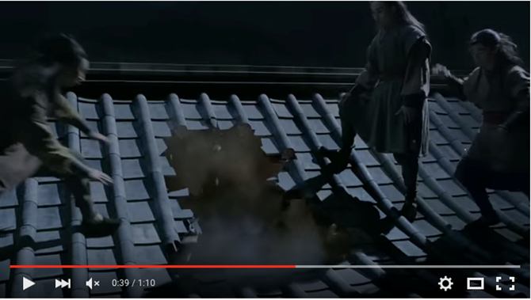
In this other shot it shows that Cheung has done something really stupid and has now fallen through a roof and fallen in side the house.

Slide 8
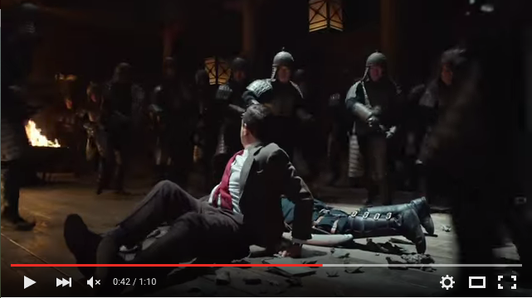
Now on this scene it shows that Cheung has fallen in to a building filled with Chines soldiers and he is surounded.

Slide 9
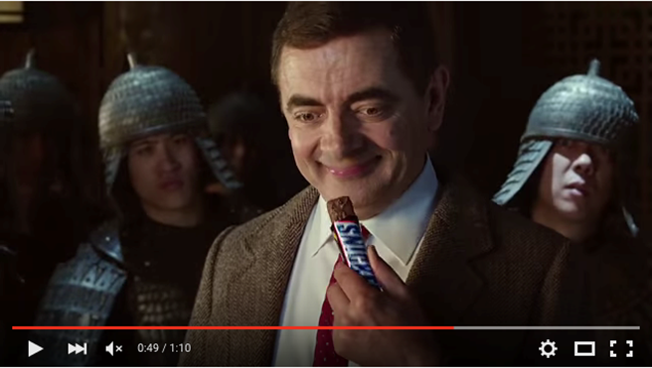
In this shot we see that Cheung has been given Snickers to focus on what he is really meant to be doing.

Slide 10
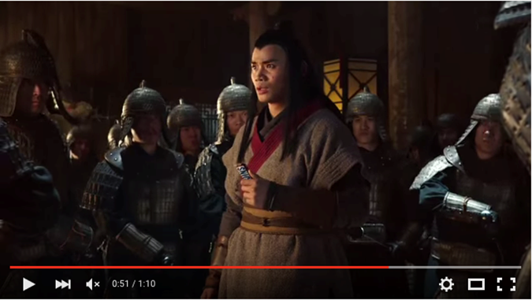
Now we see that Cheung is better and he is back to normal than being a complete idiot like Mr Bean who he was earlier.

Slide 11
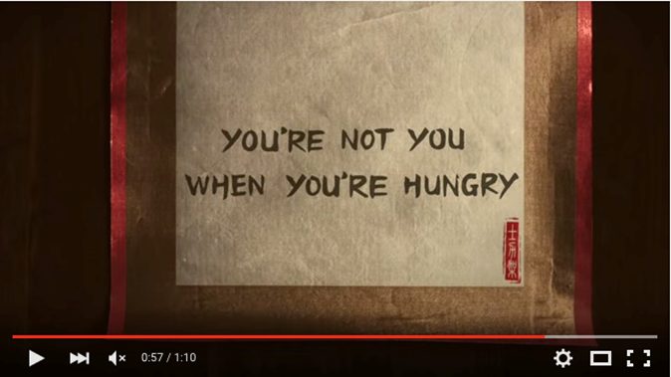
On this shot it says that “your not you when you’re hungry” in which it means that the advert use’s this slogan to refer to the Snickers that they are selling.

Slide 12
And then the final shot it comes up with the Snickers bar and the logo so the people there advertising it to no what it looks like and if they enjoy the stuff they put inside it.

